Slide 1
DAY 2 – BASICS OF JAVA
- G Sunil Kumar

Slide 2
Table Of Contents
1. Java Tokens, Variables, Keywords and Datatypes
2. New, Class, Object
3. Access modifiers
4. Constructors
5. Inheritance
6. Polymorphism
7. Abstract Class and Abstract Method
8. Interfaces
9. Garbage Collection
10. Package and Import
11. Stack Trace
12. Exception Handling
13. Assignment Problems

Slide 3
Java Tokens
A token is the smallest element in a program that is meaningful to the compiler.
Five types of token exist.
A | Identifiers | Identifiers are names provided by you. These can be assigned to variables, methods, functions, classes etc. to uniquely identify them to the compiler.
B | Keywords | Keywords are reserved words that have a specific meaning for the compiler. They cannot be used as identifiers. Java has a rich set of keywords. Some examples are: boolean, char, if, protected, new, this, try, catch, null, threadsafe etc.

Slide 4
Java Literals, Operators
C | Literals | Literals are variables whose values remain constant throughout the program. They are also called Constants. Literals can be of four types. They are: a. String Literals b. Character Literals c. Boolean Literals d. Numeric Literals String s = "this is a string"; Char a = '\u041D'; true or false
D | Operators | An operator is a symbol that operates on one or more operands to produce a result.
E | Separators | Separators are symbols that indicate the division and arrangement of groups of code.

Slide 5
Java – Variables
Instance Variables | Objects store their individual states in “non-static fields”, that is, fields declared without the static keyword
Class Variables | Exactly one copy of this variable in existence, regardless of how many times the class has been instantiated E.g. static int numGears = 5;
Local Variables | A local variable is a variable which is either avariable declared within the function or is an argument passed to a function E.g. int count = 0;
Parameters | They are the variables that are passed to the methods of a class.

Slide 6
Java Keywords
In Java, a keyword is a word with a
predefined meaning in Java programming
language syntax. Reserved for Java,
keywords may not be used as identifiers
for naming variables, classes, methods
or other entities.
E,g. boolean, byte, short, char, double,
int, long, float.
byte | 1 byte | −128 to 127
short | 2 bytes | −32768 to 32767
int | 4 bytes | −2,147,483,648 to 2,147,483,647
long | 8 bytes | 9,223,372,036,854,775,808 to 9,223,372,036,854,755,807
float | 4 bytes | 3.4e−038 to 3.4e+038 Float and double to represent numbers with decimal part
double | 8 bytes | 1.7e−308 to 1.7e+038
char | 2 bytes | ‘u0000’ (or 0) and a maximum value of ‘uffff’ or 65535 in total

Slide 7
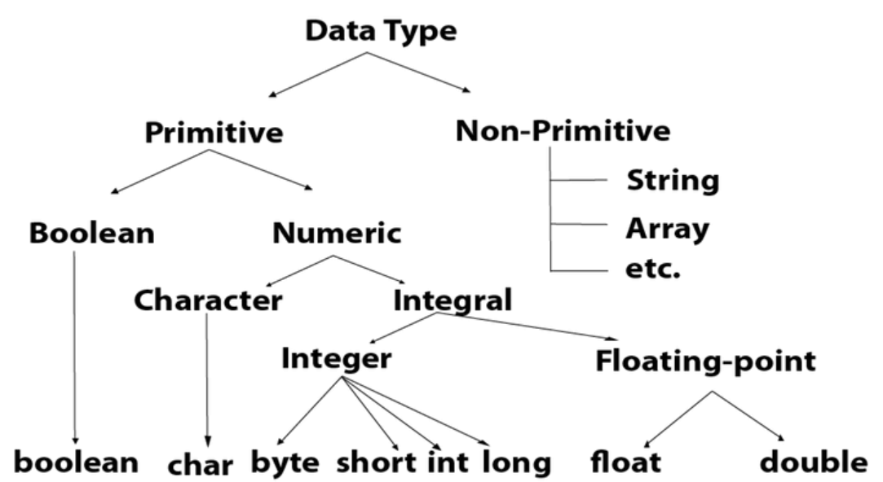
Java Data types
Data types specify the different sizes and values that can be stored in the variable. There are two types of data types in Java:
Primitive data types: The primitive data types include boolean, char, byte, short, int, long, float and double.
Non-primitive data types: The non-primitive data types include Classes, Interfaces, and Arrays.

Slide 8
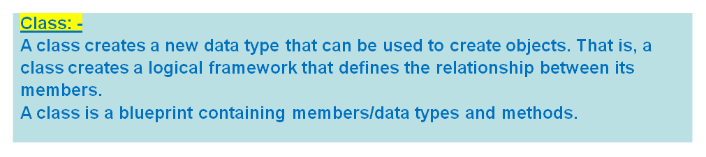
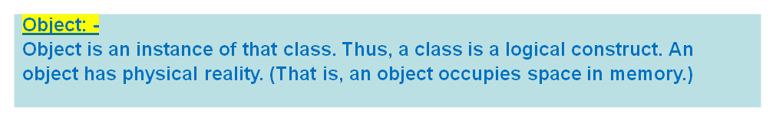
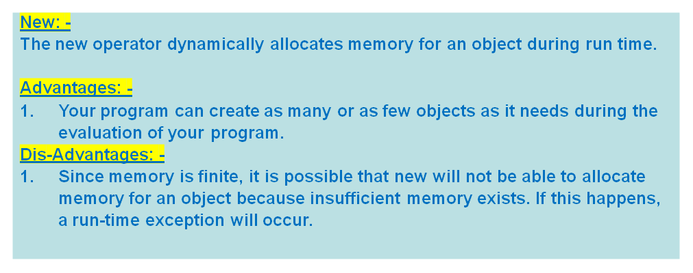
Class, Object, New Operator

Slide 9
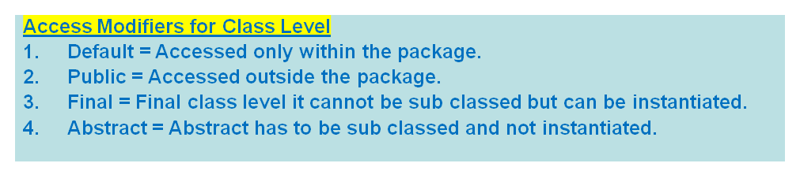
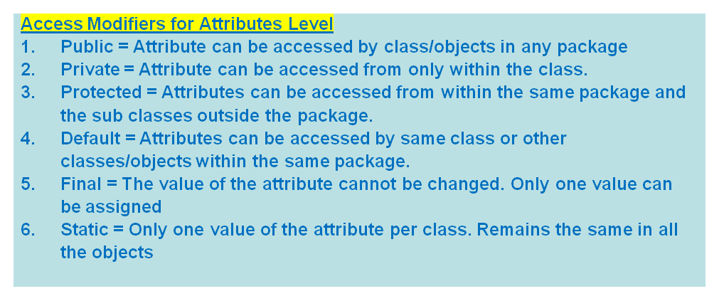
Access Modifiers – Method, Class Level
Access Modifiers
Access modifiers are those which set access levels for classes, attributes, methods and constructors.

Slide 10
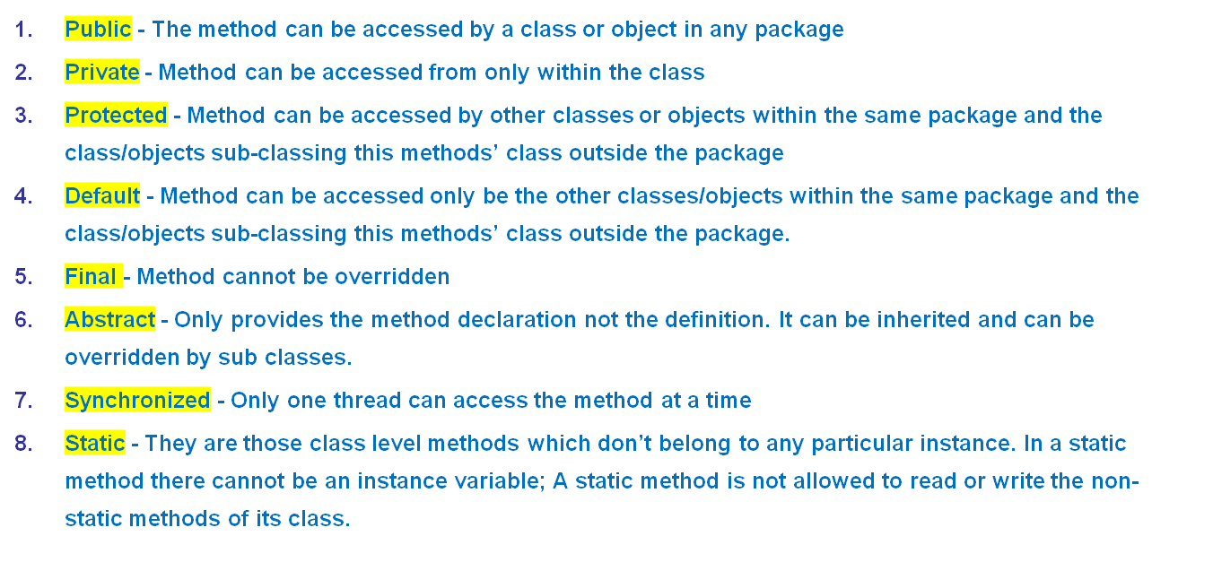
Access Modifiers – Method Level

Slide 11
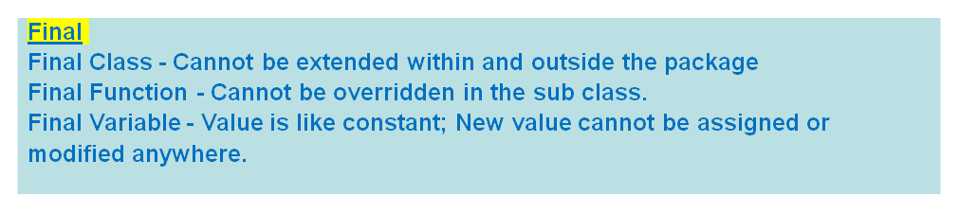
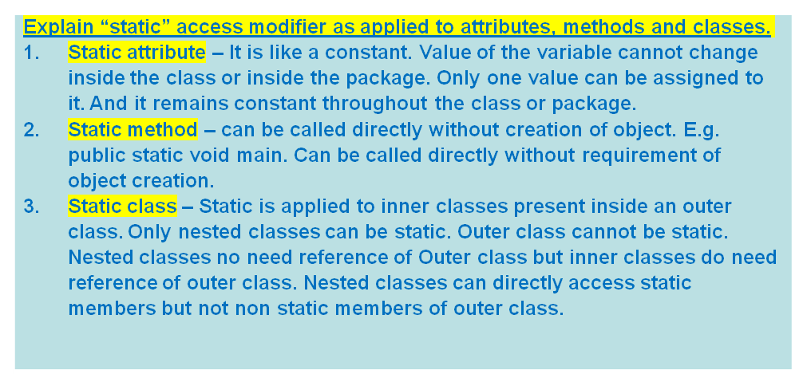
Final And Static Modifiers

Slide 12
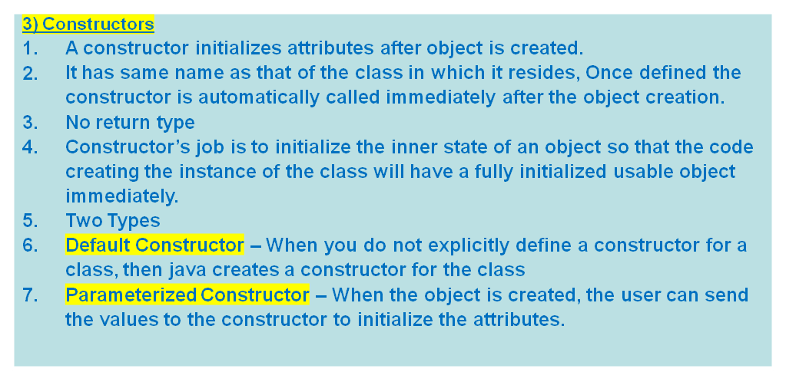
Java Constructor

Slide 13
Copy Constructor
Copy Constructor
Frequently we need to use the same values used in the different object to initialize the current object.
In that case we need to pass the object itself as the parameter.
public CubePrime { double w; double h; double l; Cube(double a,double b, double c) { w=a; h=b; l=c; } Cube (Cube obj) { w = obj.w; h= obj.h; l= obj.l; } public static void main (String args) { Cube obj1 = new Cube(10,20,30); Cube obj2 = new Cube(obj1); } }

Slide 14
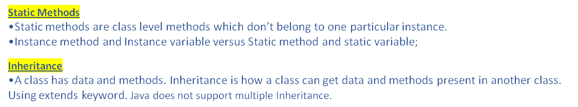
Static Method and Inheritance
public class A { int i,j; void showij() { System.out.println(i+""+ j); } } public class B extends A { int k; void showk() { System.out.println(k);} void sum() { int sum = i+j+k; System.out.println(sum); } } public static void main(String args[]) { A superOb = new A(); B subOb = new B(); // Below can be done since B inherits the members and methods of A B.i = 7; B.j = 8; B.k= 9; B.sum();// Outputs 24 as result } }

Slide 15
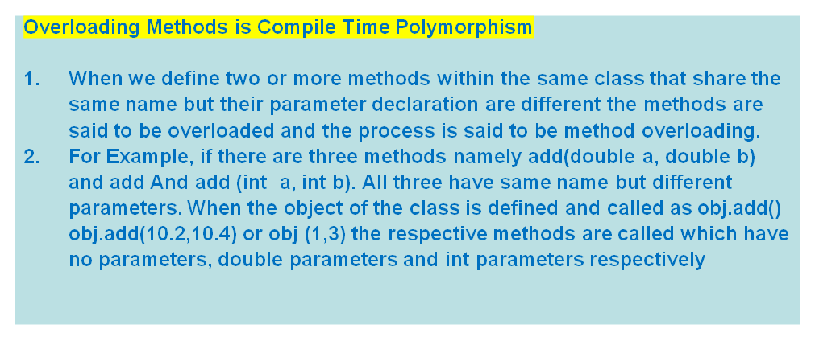
Polymorphism – Compile Time

Slide 16
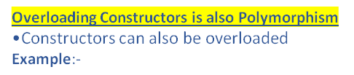
Polymorphism – Constructor
public class Cube { double width; double height; double length; // Three overloaded constructors Cube() { width = -1; height =-1; length = -1; } Cube (double x) {width = x; height = x; length = x;} Cube(double w,double h,double l) {width = w; height=h; length = l;} public static void main (String args[]) { // All three are valid Cube c1 = new Cube(); Cube c2 = new Cube(3.2); Cube c3= new Cube (3.1, 2.4, 4.5); } }

Slide 17
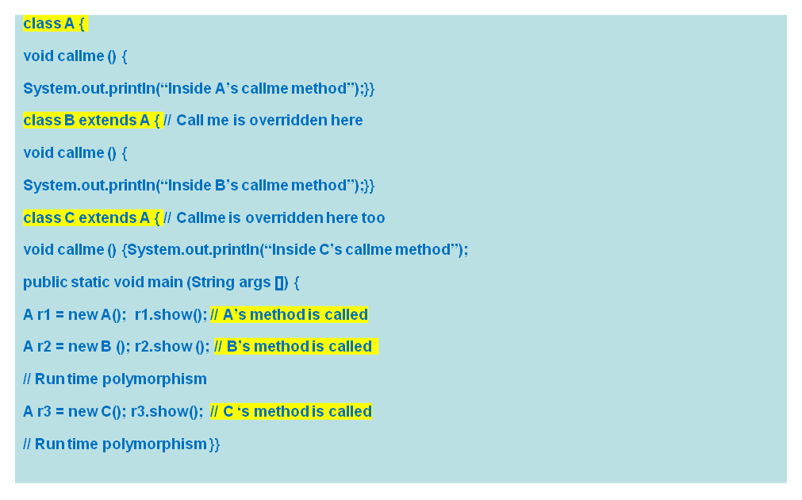
Polymorphism – Run Time
Call to an overridden method is resolved at run time In own words, suppose a class has members and method. The sub class inheriting from the super class has the same method (overridden method). Now we define a super class object and a sub class object. Now when we create a reference variable of super class and then assign the object of the sub class, then at run time the compiler determines at run time that the sub class method needs to be called. Concept - Reference variable of a super class can be assigned the object of a sub class. This causes run time polymorphism.

Slide 18
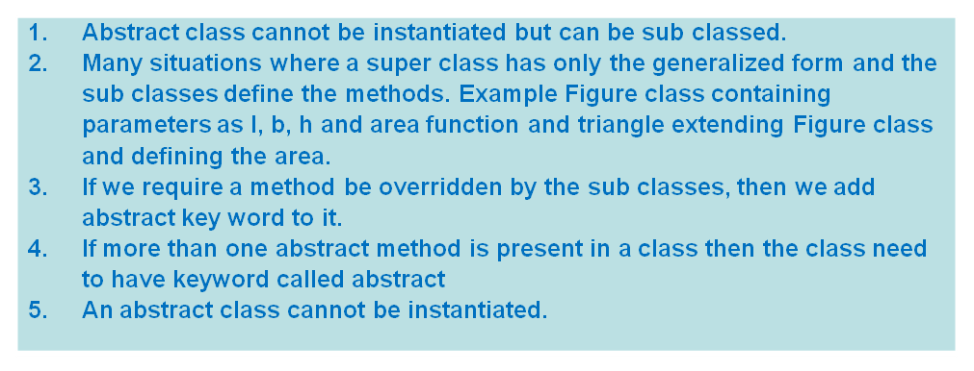
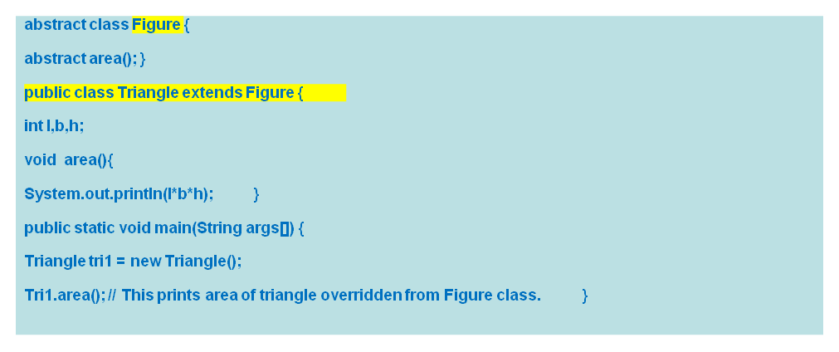
Abstract Class, Method

Slide 19
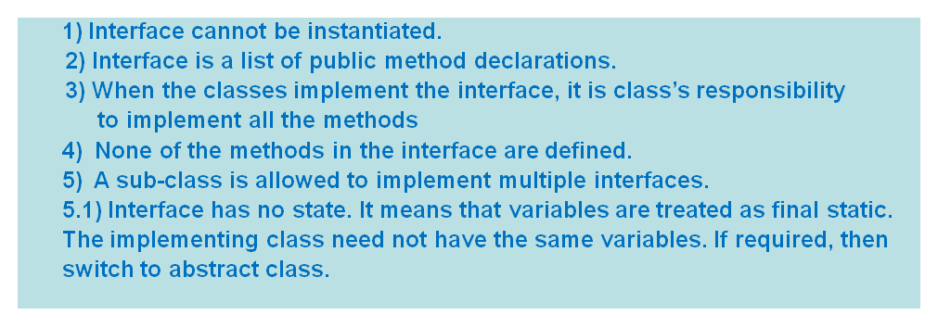
Interfaces
public interface Figure { public void area(); public void perimeter(); } public class Rectangle implements Figure { int l, int b; public void area() { int area = l *b;} public void perimeter() {int peri = 2*(l+b); } } public class Square implements Figure { int s; public void area () {int area = s * s;} public void perimeter() {int perimeter = 4*s} }

Slide 20
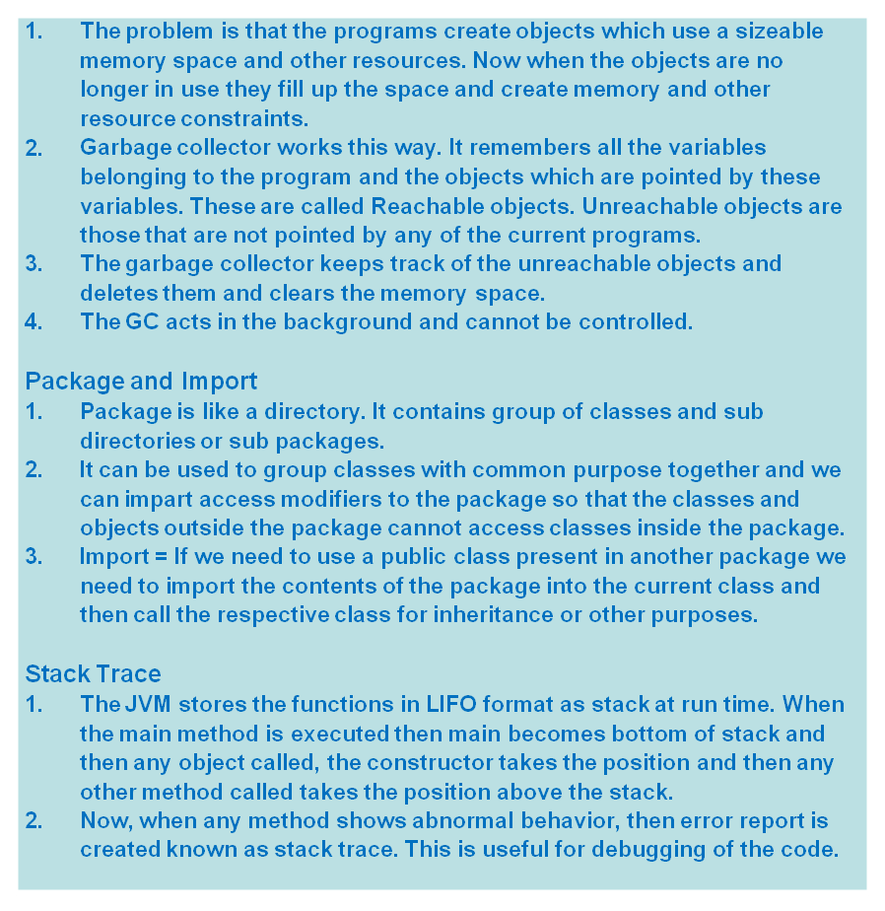
Garbage Collection, Package, StackTrace

Slide 21
Exception Handling
Java exception Handling is managed via five key words – try, catch, finally, throw and throws.
Exception handling means error handling. Error due to programmer or due to the system happening at the run time.
Exception Process - When the exception happens, an object representing that exception is created and thrown in the method that caused the error. The method may catch it or throw back. At some point exception is caught and then processed.
class Exc0 { public static void main (String args[]) { int d,a; try { // Monitoring the block of code for Arithmetic Exception d =0; a = 42/d; System.out.println(“This line is not printed.”); } catch (ArithmeticException e) { System.out.println(“Division by Zero”); } }}

Slide 22
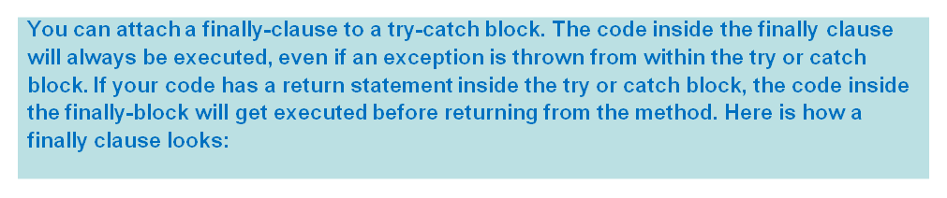
Multi Catch and Finally
class MultiCatch { public static void main (String args[]) { try { // Manually monitoring the block for int a = Integer.parseInt(args[0]); int b = 42/a; } catch (ArithmeticException ae ) { System.out.println(“Divide by zero”); } catch(ArrayOutOBoundsException e) { System.out.println(“No Command line argument present.”); } catch (NumberFormatException e) { System.out.println(“Command Line argument is not a number.”); } }}

Slide 23
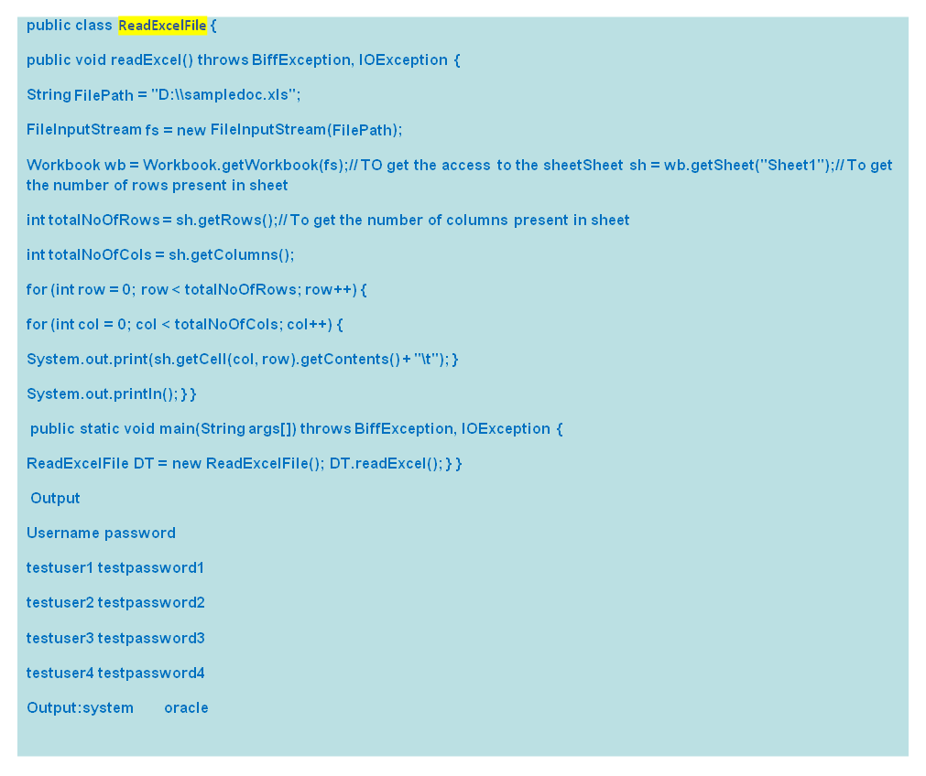
Excel File Reading and Writing

Slide 24
Java Enum
class EnumExample1{ public enum Season { WINTER, SPRING, SUMMER, FALL } public static void main(String[] args) { for (Season s : Season.values()) System.out.println(s); }} Output: WINTERSPRINGSUMMERFALL
class EnumExample4{ enum Season{ WINTER(5), SPRING(10), SUMMER(15), FALL(20); private int value; private Season(int value){ this.value=value; } } public static void main(String args[]){ for (Season s : Season.values()) System.out.println(s+" "+s.value); }} Output: WINTER 5SPRING 10SUMMER 15FALL 20

Slide 25
Java Date Object to String Conversion
Letter | Description | Examples
y | Year | 2013
M | Month in year | July, 07, 7
d | Day in month | 1-31
E | Day name in week | Friday, Sunday
a | Am/pm marker | AM, PM
H | Hour in day | 0-23
H | Hour in am/pm | 1-12
m | Minute in hour | 0-60
s | Second in minute | 0-60
SimpleDateFormat formatter = new SimpleDateFormat("dd-MMM-yyyy"); String dateInString = "7-Jun-2013"; try { Date date = formatter.parse(dateInString); System.out.println(date); System.out.println(formatter.format(date)); } catch (ParseException e) { e.printStackTrace(); } Output Fri Jun 07 00:00:00 MYT 201307-Jun-2013

Slide 26
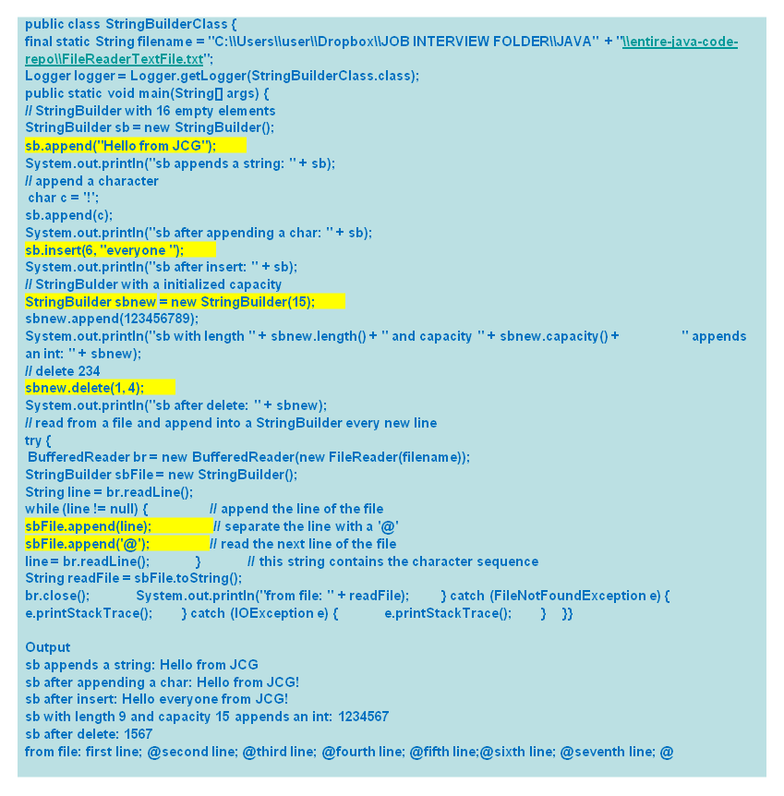
Java String Builders

Slide 27
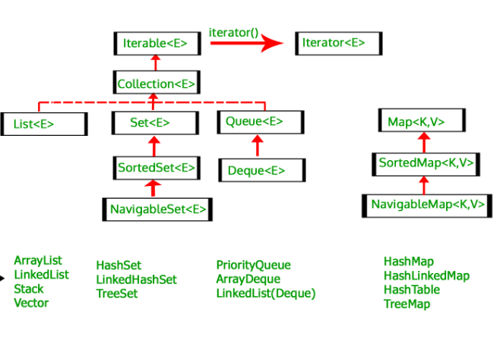
Collections – Integer Arrays
int check[] = {1,1,2,3,5,8}; n = check.length // checking the size. int fibo[] = new int[10]; fibo[0] = 1; // filling values fibo[1] = 1; m = fibo.length; // checking the size.

Slide 28
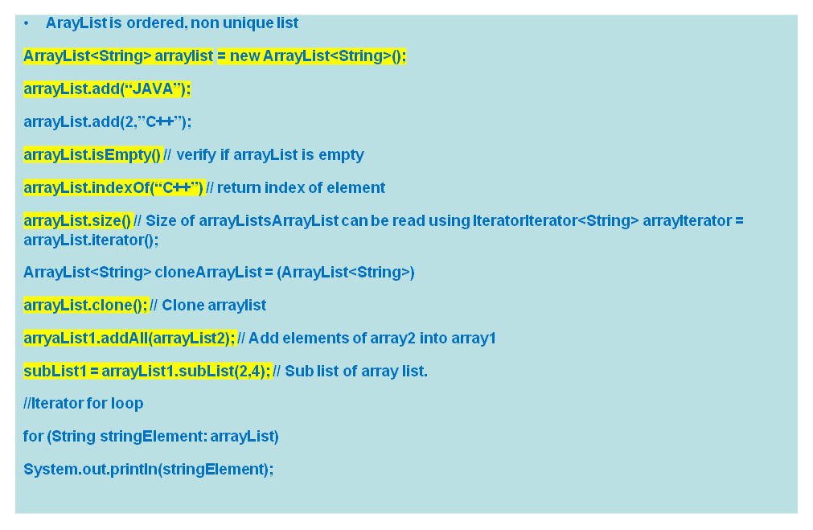
Collections - Array List

Slide 29
Collections - Iterator
List<String> myList = new ArrayList<String>(); myList.add(“Java”); myList.add(“Unix”); Iterator<String> itr = myList.iterator(); while(itr.hasNext()) { System.out.println(itr.next());}

Slide 30
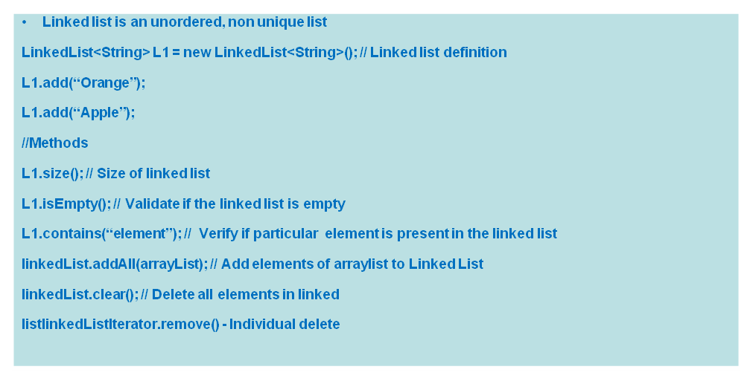
Collections – Linked List

Slide 31
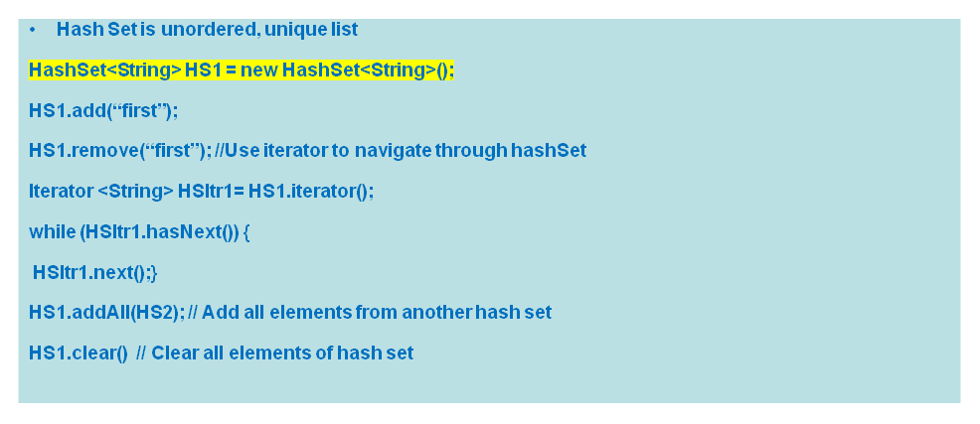
Collections – Hash Set

Slide 32
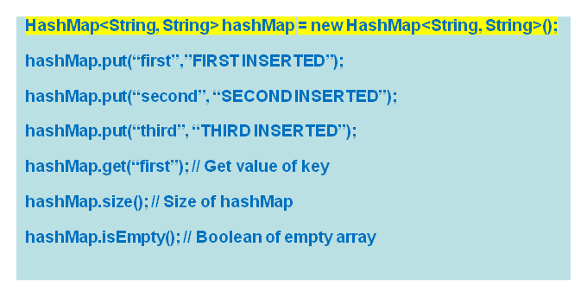
Collections – Hash Map
HashMap is unsorted key value pair collection

Slide 33
Data Structures – Linear Search
O(n)is the speed of iteration public static int linearSearch(int[] arrayList,int searchValue) { int size = arrayList.length; for (int i=0; i< size; i++) { if(arrayList[i]==searchValue) return i;}

Slide 34
Data Structures – Binary Search
Binary Search Algorithm returns location of the element in a sorted array
log(n) Speed of iteration
public int binarySearch( ArrayList<Integer> arrayList, searchValue) {{int start =0;int end = arrayList.size() -1; while (start<=end) {int mid = (start+ end)/2; if (searchValue == arrayList.get(mid))return mid; if (searchValue > arrayList.get(mid))start = mid + 1; if (searchValue < arrayList.get(mid)) end = mid -1; }return -1;}

Slide 35
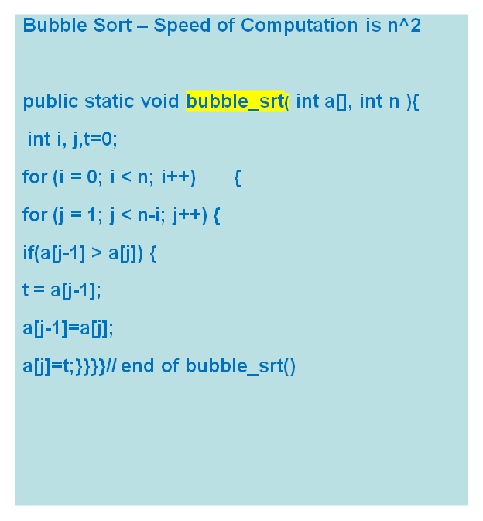
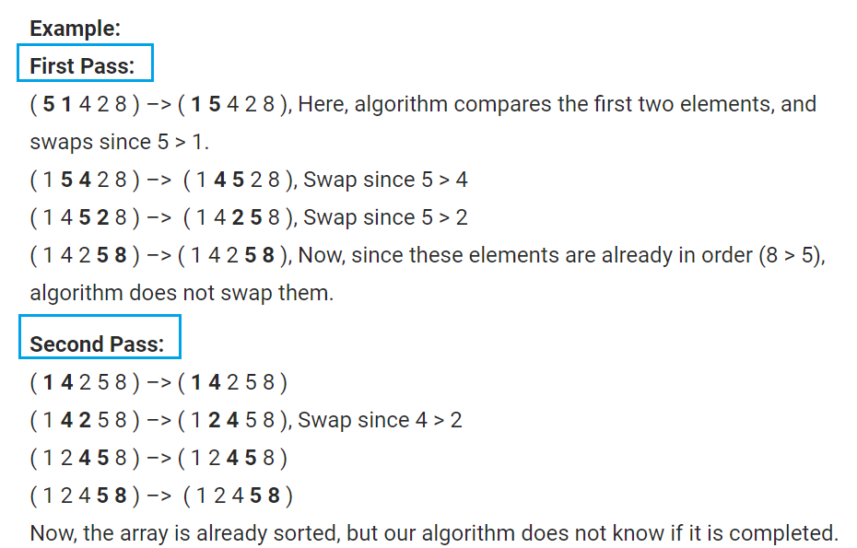
Data Structures – Bubble Sort

Slide 36
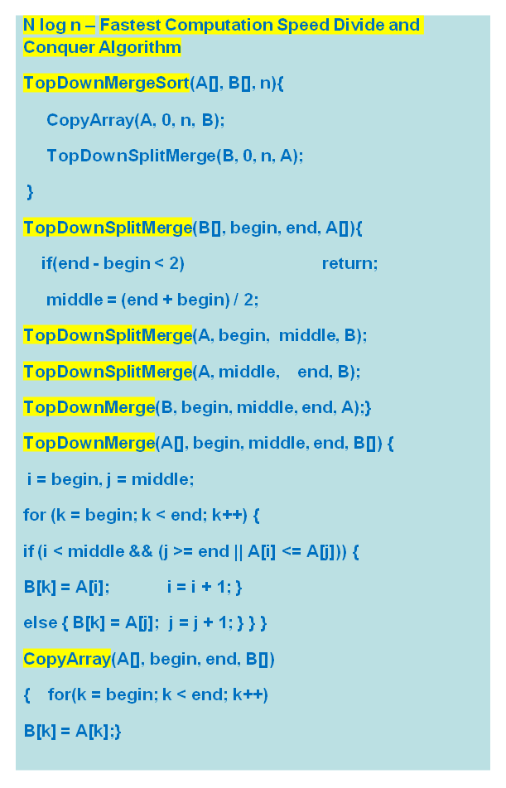
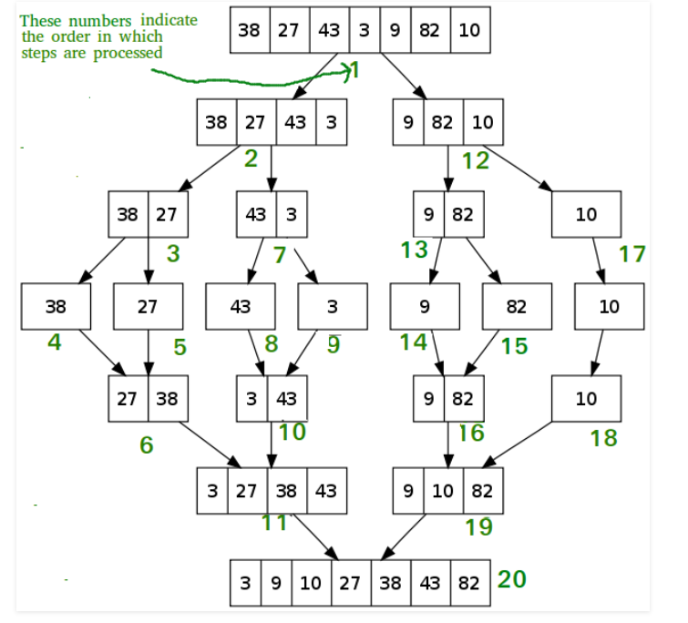
Data Structures – Merge Sort

Slide 37
REFERENCES
1. Java - https://www.javatpoint.com/java-data-types

Slide 38
THANK YOU

Slide 39


